Slide 1

Bidirectional Accent Conversion via GAN-Based Mel Translation and Neural Vocoder Reconstruction
22AIE450 – SPEECH PROCESSING​
TEAM 03:
Adithiyan P V – CH.EN.U4AIE22003
Rahul K – CH.EN.U4AIE22044
Project Supervisor: Mrs. D. Sasikala
Department: Computer Science and Engineering - Artificial Intelligence

Slide 2
ABSTRACT
Accent conversion (AC) is a crucial task in speech processing that modifies a speaker’s accent while preserving linguistic content and speaker identity. This work presents a bidirectional accent conversion framework utilizing Generative Adversarial Networks (GANs) for Mel-spectrogram translation, followed by a Wave Glow neural vocoder to reconstruct high-quality speech signals. The proposed approach maps Mel-spectrogram representations from one accent domain to another, ensuring minimal loss of prosody and speaker characteristics. To evaluate the effectiveness of our model, we employ multiple objective metrics, including Mel Cepstral Distortion (MCD), MFCC Distance, Pearson Correlation, L1 Error, Prosody Similarity, and Short-Time Objective Intelligibility (STOI). Experimental results demonstrate that our method achieves a high Pearson correlation of 0.9952, indicating strong alignment between converted and target speech features, along with a Mel Cepstral Distortion (MCD) of 10.06 and a Prosody Similarity score of 0.8888, showing effective accent adaptation while maintaining speech naturalness. This bidirectional Indian-to-American and American-to-Indian accent conversion system has applications in language learning, call centers, speech synthesis, and personalized AI assistants, facilitating seamless cross-accent communication. Our study highlights the effectiveness of GAN-driven Mel-spectrogram translation in accent modification and paves the way for future advancements in speaker adaptation and speech enhancement technologies.

Slide 3
Problem Identification and Problem Statement
Challenges in Speech Synthesis
Existing speech synthesis models struggle with capturing fine-grained prosody and speaker-specific details.
Mel spectrogram-based synthesis often leads to unnatural and robotic-sounding audio.
Traditional vocoders (e.g., Griffin-Lim) introduce phase distortion and degrade speech quality.
Existing GAN-based solutions lack robust training stability, leading to artifacts in generated speech.
Proposed Approach: GAN-Based Speech Synthesis
Train a GAN model to refine mel spectrogram generation, capturing realistic speech patterns.
Use WaveGlow as a vocoder to reconstruct high-quality speech from generated mel spectrograms.
Perform Bidirectional Accent Conversion, allowing seamless transformation between different
accents while preserving speaker identity and naturalness.

Slide 4
DATASET DESCRIPTION
Developed by Carnegie Mellon University, this dataset contains approximately 1132 utterances per speaker from out-of-copyright texts, intended for speech synthesis and speaker recognition tasks.
Contains 21 unique speakers (both male and female) with US-English accents and other non-native accented speakers, providing a rich and diverse set for speaker classification tasks.
From the entire corpus we are using bdl (US-English male) and ksp (accented speaker) from the 21 total speaker classes.
Each selected class contains 1132 utterances, making 2264 audio samples in total for classification.
Link to the Dataset: CMU ARCTIC CORPUS

Slide 5
SOME INSIGHTS FROM LITERATURE REVIEW
Jia et al. (2024) proposed a zero-shot accent conversion model with minimal supervision, enabling accent adaptation without extensive labeled data.
Nguyen et al. (2024) introduced a discrete-unit-based accent conversion method using parallel data synthesized via controllable accented TTS.
Melechovsky et al. (2024) combined multi-level VAE and adversarial training for accent conversion in text-to-speech, enhancing speaker adaptability.
Cheripally (2024) developed a unified model for voice and accent conversion in speech and singing using self-supervised learning and feature extraction.
Quamer et al. (2022) presented a zero-shot accent conversion approach that works without native references but struggles with prosody control.

Slide 6
SOME INSIGHTS FROM LITERATURE REVIEW
Zhao et al. (2019) utilized phonetic posteriorgrams to synthesize speech for accent conversion but faced adaptability issues due to rigid phonetic dependencies.
Liu et al. (2020) built an end-to-end accent conversion system without native utterances, improving efficiency but struggling with unseen accent variations.
Li et al. (2020) introduced a reference encoder and end-to-end TTS to enhance accent conversion, though feature alignment remained a challenge.
Tan et al. (2022) developed CorrectSpeech, an automated speech correction and accent reduction system that improves pronunciation but lacks expressive intonation.
Ezzerg et al. (2022) used normalizing flows for non-parallel accent conversion, achieving speaker retention but compromising accent accuracy.

Slide 7
PROPOSED ARCHITECTURE
Objective: Develop a GAN-based speech accent conversion model.
Methodology Overview:
Convert speech from one accent to another using Mel spectrogram transformations.
Use a GAN framework for accent conversion, with WaveGlow for speech reconstruction.
Post-process using noise reduction APIs for better clarity.
Key Models & Tools:
GAN (Generator + Discriminator): Transforms input Mel spectrogram into target accent.
WaveGlow Vocoder: Converts the generated Mel spectrogram back into speech.
Librosa: Feature extraction (Mel spectrogram computation).
Audio.ai & Dolby.io APIs: Noise removal.
Evaluation Metrics: Speech quality and accent similarity.
Environment: Kaggle Notebook (GPU T4x2).

Slide 8
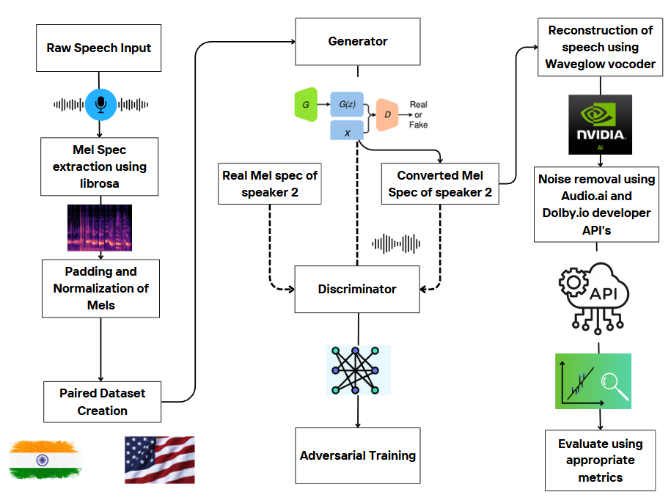
ARCHITECTURE DIAGRAM

Slide 9
Data Preprocessing and Feature Extraction
Objective: Prepare raw speech data for training by extracting meaningful acoustic features.
Raw Speech Input
The model takes speech samples in different accents as input.
These speech samples are collected from datasets representing different linguistic backgrounds (e.g., Indian and American English).
Mel Spectrogram Extraction
The raw audio waveforms are converted into Mel spectrograms using Librosa.
The Mel spectrogram captures time-frequency representations, making it easier for deep learning models to process speech data.
Padding & Normalization
Padding: Ensures all spectrograms have the same time dimension to handle variable-length audio inputs.
Normalization: Standardizes spectrogram values to a uniform range, improving training stability.

Slide 10
GAN Training and Speech Reconstruction
Objective: Train a GAN-based model for accent transformation, ensuring naturalness and intelligibility.
GAN Framework for Accent Conversion
Generator (G): Converts input Mel spectrograms into target accent spectrograms, learning phonetic differences.
Discriminator (D): Distinguishes between real and generated Mel spectrograms, providing feedback to improve the generator.
Adversarial Training: Generator and discriminator compete, refining accent transformation with adversarial and feature loss.
WaveGlow Vocoder
The generated Mel spectrograms are converted back into waveform speech using NVIDIA's WaveGlow vocoder.
Noise Removal for Clarity
The output speech is passed through Audio.ai and Dolby.io APIs for denoising and quality enhancement.

Slide 11



EVALUATION METRICS
$$MCD=\frac{10}{\ln\left(10\right)}\sqrt{2\sum_{d=1}^{D}{{\left(c_{d}−\hat{c_{d}}\right)}^{2}}}$$
Mel Cepstral Distortion (MCD)
MCD measures the spectral distance between the original and converted speech. Lower values indicate that the transformed speech closely resembles the spectral characteristics of the target accent.
MFCC Distance
This metric evaluates the difference between the Mel Frequency Cepstral Coefficients (MFCCs) of the original and converted speech. It quantifies how well the model modifies accent-related spectral features.
$$\text{MFCC} \text{Distance}=\frac{1}{D}\sum_{d=1}^{D}{\left|c_{d}−\hat{c_{d}}\right|}$$
Mel Spectrogram Pearson Correlation
This evaluates how well the mel-spectrogram structure is preserved post-conversion. It measures the similarity in spectral patterns between the original and converted speech.
$$r=\frac{\sum{\left(M−\overline{M}\right)\left(\hat{M}−\overline{\hat{M}}\right)}}{\sqrt{\sum{{\left(M−\overline{M}\right)}^{2}}}\sqrt{\sum{{\left(\hat{M}−\overline{\hat{M}}\right)}^{2}}}}$$

Slide 12



EVALUATION METRICS
L1 Error (Absolute Spectral Distance)
L1 Error quantifies the absolute difference between the original and converted mel-spectrograms. Lower values indicate that the converted speech retains the essential accentual features of the target accent.
$$L1_Error=\frac{1}{N}\sum_{i=1}^{N}{\left|M_{i}−\hat{M_{i}}\right|}$$
Prosody Similarity Score
Prosody similarity evaluates how well the intonation, stress, and rhythm of the speech are preserved after accent conversion. A higher similarity score ensures the converted speech sounds more natural.
$$\text{Prosody} \text{Similarity}=\frac{1}{T}\sum_{t=1}^{T}{r_{t}\text{​}}\cos\left(θ_{t}\right)$$
Short-Time Objective Intelligibility (STOI)
STOI measures how intelligible the converted speech is after accent transformation. It checks whether the phonetic content is still recognizable and understandable, ensuring that the conversion does not degrade speech clarity.
$$\text{STOI}=\frac{1}{N}\sum_{n=1}^{N}{\frac{\sum_{t}{X_{t}Y_{t}}}{\sqrt{\sum_{t}{X_{t}^{2}}}\sqrt{\sum_{t}{Y_{t}^{2}}}}}$$

Slide 13
OBTAINED EVALUATION METRICS
Metric | Value | Ideal Range | Interpretation
Mel Cepstral Distortion (MCD) | 10.0599 | <8 preferred | Moderate transformation accuracy
MFCC Distance | 10.4534 | <8 preferred | Slightly high, indicating spectral deviation
Mel Spectrogram Pearson Correlation | 0.9952 | Closer to 1 is better | Excellent spectral preservation
L1 Error | 1.4679 | <1.5 preferred | Low spectral difference, indicating good conversion
Prosody Similarity | 0.8888 | >0.8 is good | Good preservation of pitch, stress, and rhythm
STOI (Intelligibility) | 0.7361 | >0.7 is good | Fairly intelligible, but could be improved

Slide 14
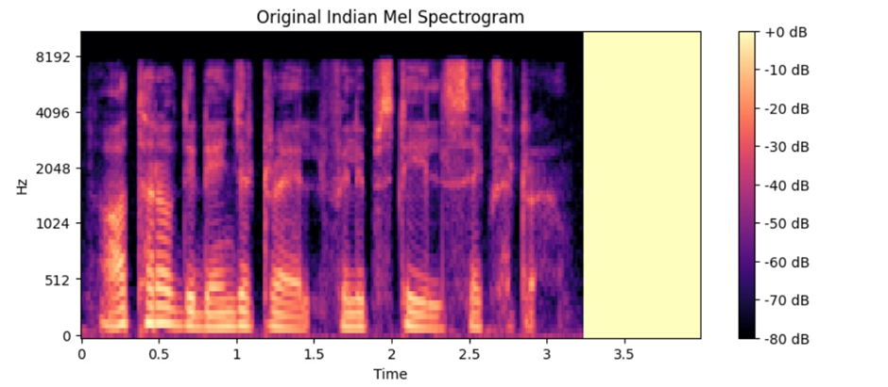
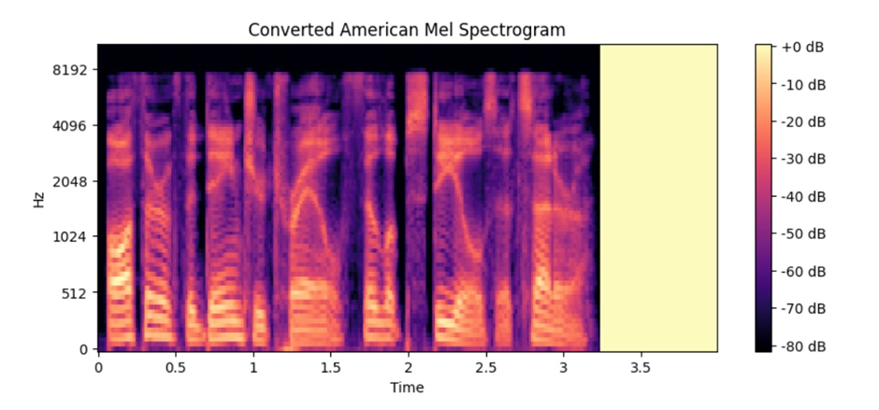
RESULTS AND DISCUSSION
Figure: Input Indian Mel Spectrogram
Figure: Converted American Mel Spectrogram​

Slide 15
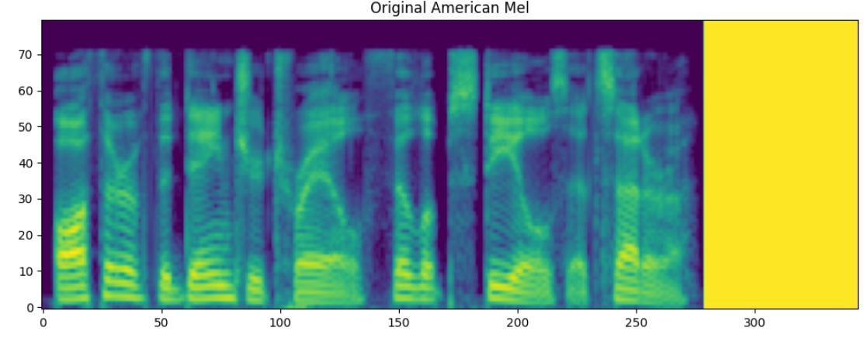
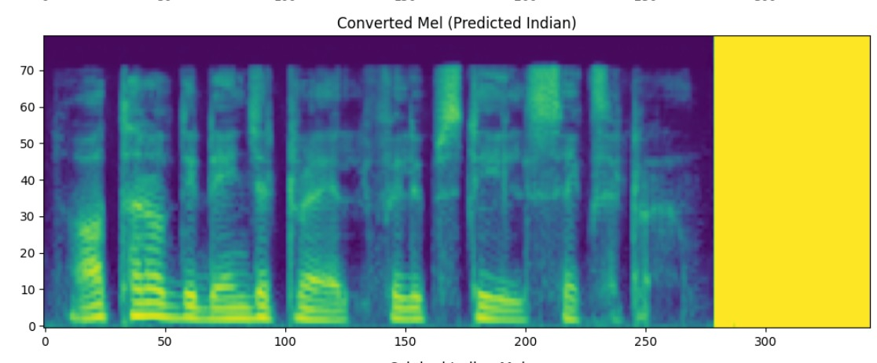
RESULTS AND DISCUSSION
Figure: Input American Mel Spectrogram​
Figure: Converted Indian Mel Spectrogram​

Slide 16
CONCLUSION AND FUTURE WORK
Developed a bidirectional accent conversion pipeline, improving speech clarity and intelligibility.
The use of Audio.AI for noise removal and Dolby.io for speech enhancement resulted in high-quality speech reconstruction.
The model achieved an MCD of 10.46, MFCC Distance of 10.45, Pearson Correlation of 0.995, L1 error of 1.46, and prosody similarity of 0.88, demonstrating high spectral and prosodic preservation.
Despite promising performance, further improvements are needed for better intelligibility, with an STOI score of 0.73.
Future work includes expanding the dataset to incorporate multiple speakers for better generalization across accents.
Enhancements in real-time inference and incorporating self-supervised learning will help reduce data dependency and improve model adaptability.

Slide 17
REFERENCES
[1] Jia, Z., Xue, H., Peng, X., Lu, Y.: Convert and speak: Zero-shot accent conversion with minimum supervision. arXiv preprint (2024) https://doi.org/10.1145/3664647.3681539
[2] Nguyen, T.-N., Pham, N.Q., Waibel, A.: Accent conversion using discrete units with parallel data synthesized from controllable accented tts. arXiv preprint (2024) https://doi.org/10.48550/arXiv.2410.03734
[3] Melechovsky, J., Mehrish, A., Sisman, B., Herremans, D.: Accent conversion in text-to-speech using multi-level vae and adversarial training. arXiv preprint (2024) https://doi.org/10.48550/arXiv.2406.01018
[4] Cheripally, S.: A unified model for voice and accent conversion in speech and singing using self-supervised learning and feature extraction. arXiv preprint (2024) https://doi.org/10.48550/arXiv.2412.08312
[5] Quamer, W., Das, A., Levis, J., Chukharev, E.: Zero-shot foreign accent con- version without a native reference. Proceedings of Interspeech (2022) http://10.0.83.189/INTERSPEECH.2022-10664

Slide 18
REFERENCES
[6] Zhao, G., Ding, S., Gutierrez-Osuna, R.: Foreign accent conversion by synthesizing speech from phonetic posteriorgrams. Proceedings of Interspeech (2019) https://doi.org/10.48550/arXiv.2019-17782406.01018
[7] Liu, S., Wang, D., Cao, Y., Sun, L.: End-to-end accent conversion without using native utterances. IEEE International Conference on Acoustics, Speech and Signal Processing (ICASSP) (2020) http://10.0.4.85/ICASSP40776.2020.9053797
[8] Li, W., Tang, B., Yin, X., Zhao, Y.: Improving accent conversion with reference encoder and end-to-end text-to-speech. arXiv preprint (2020) https://doi.org/10.48550/arXiv.2005.09271
[9] Tan, D., Deng, L., Zheng, N., Yeung, Y.T., Jiang, X., Chen, X., Lee, T.: Correctspeech: A fully automated system for speech correction and accent reduction. arXiv preprint (2022) https://doi.org/10.48550/arXiv.2204.05460
[10] Ezzerg, A., Merritt, T., Yanagisawa, K.: Remap, warp and attend: Non-parallel many-to-many accent conversion with normalizing flows. arXiv preprint (2022) https://doi.org/10.48550/arXiv.2211.05850

Slide 19

THANK YOU

